Slide 1
NF Collaboration Summary
Last updated: 04/08/2024

Slide 2
Problem
Neurofilament-derived brush comprised of one or more of:
Light (156 residues) sidearm
Medium (438 residues) sidearm
Heavy (647 residues) sidearm
Response to ionic strength characterized by brush height measured through AFM
Question: role of each sidearm on overall morphology of brush and translation to biological neurofilaments

Slide 3
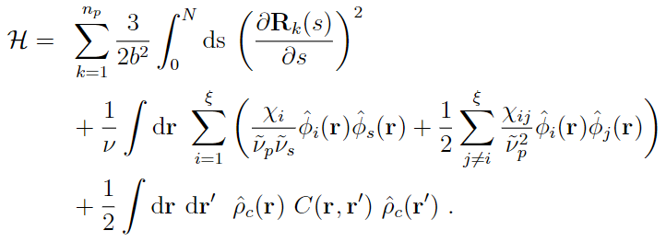
Model
Interactions
Self-consistent field theory for charged multiblock macromolecules
Coupled system of 5 algebraic equations and 2 partial differential equations
Elastic energy
Flory-Huggins (Hydrophobicity)
Electrostatics

Slide 4
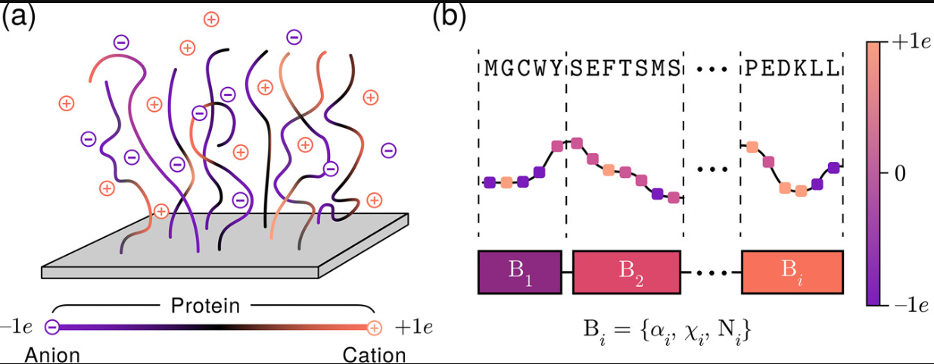
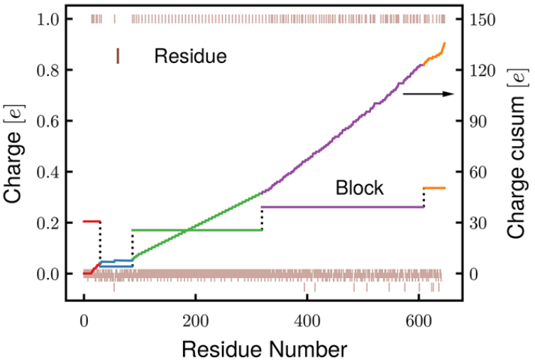
Treatment of Sequences
Protein → Multiblock charged macromolecular model
Coarse-graining by grouping similar neighboring charges (cusum method)
Yokokura et al. Biomacromolecules. 2024

Slide 5
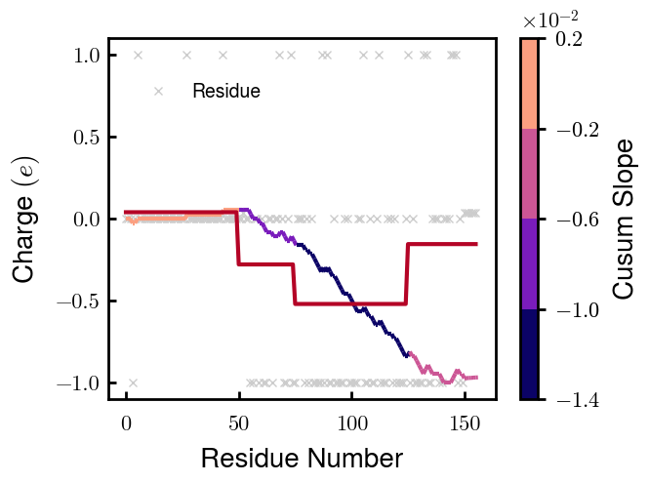
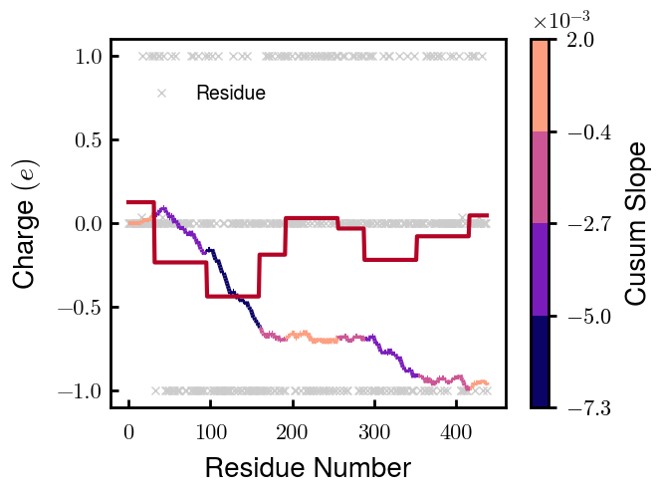
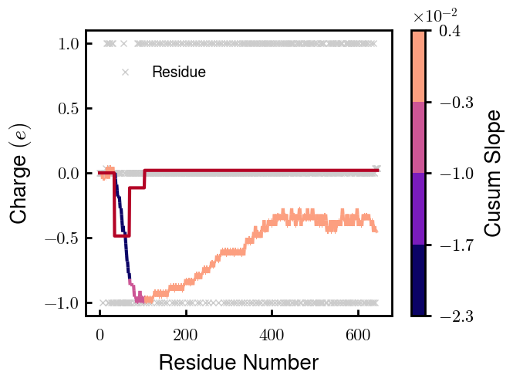
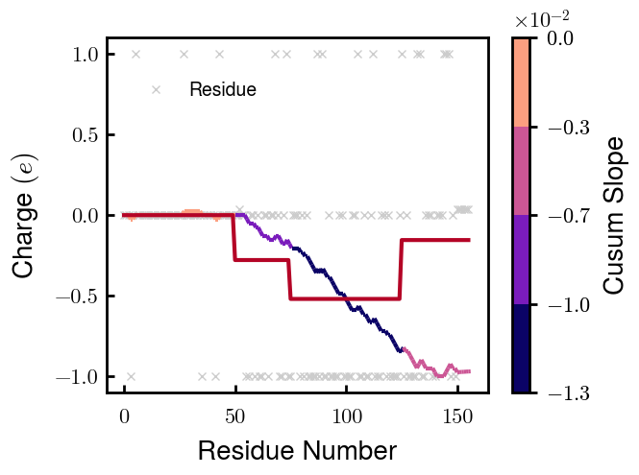
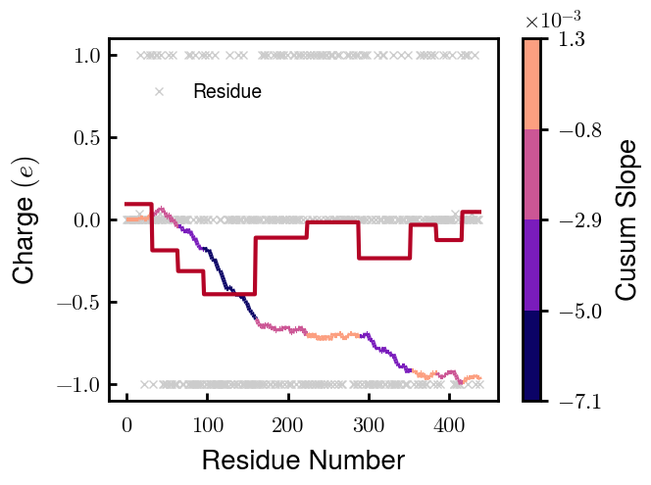
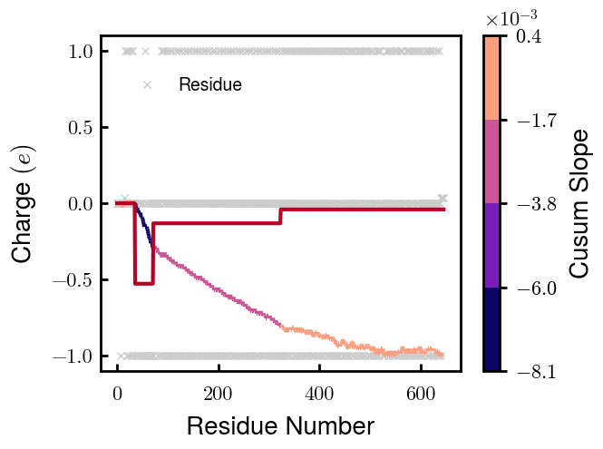
Coarse-grained Distributions (1 of 2)
NFL
NFM
NFH
Non-phospho
Phospho
Note: phospho $=−1e$ chosen for best agreement with experimentally measured heights

Slide 6
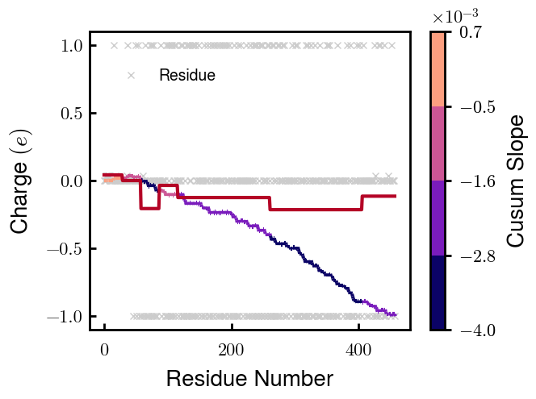
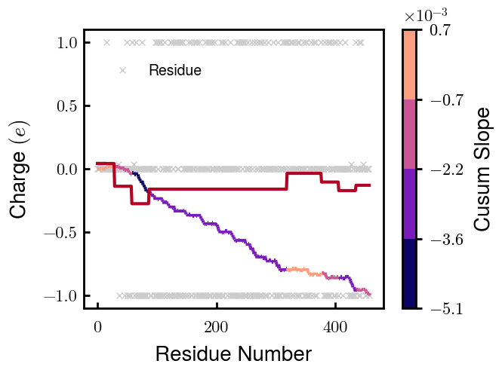
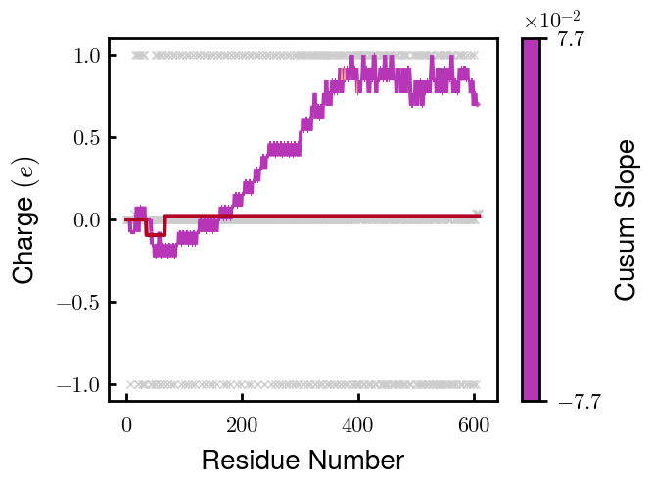
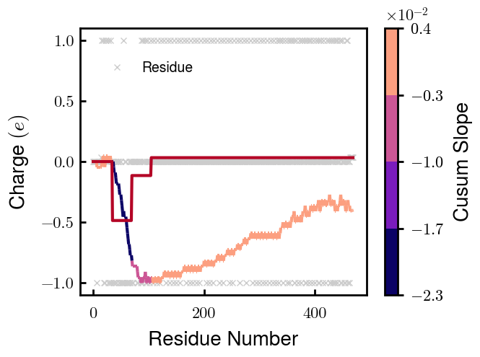
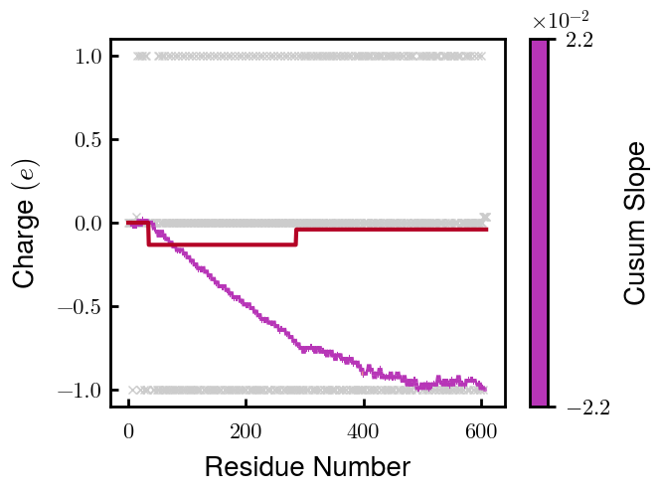
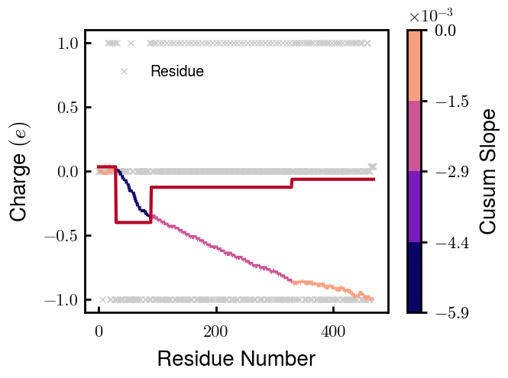
Coarse-grained Distributions (2 of 2)
NFM S1
NFM S2
NFH D2
NFH D6
Non-phospho
Phospho
—
—
Note: phospho $=−1e$ chosen for best agreement with experimentally measured heights

Slide 7
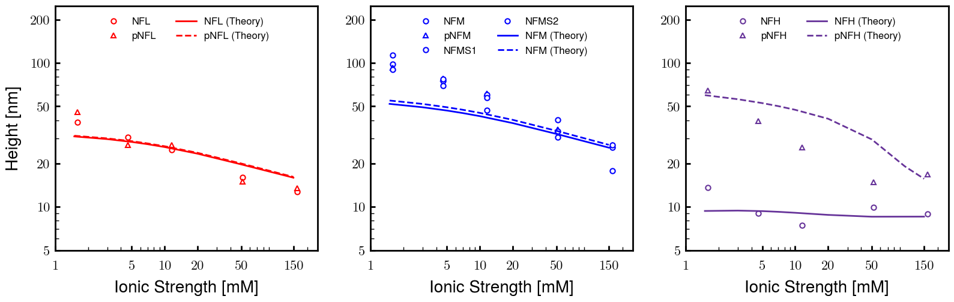
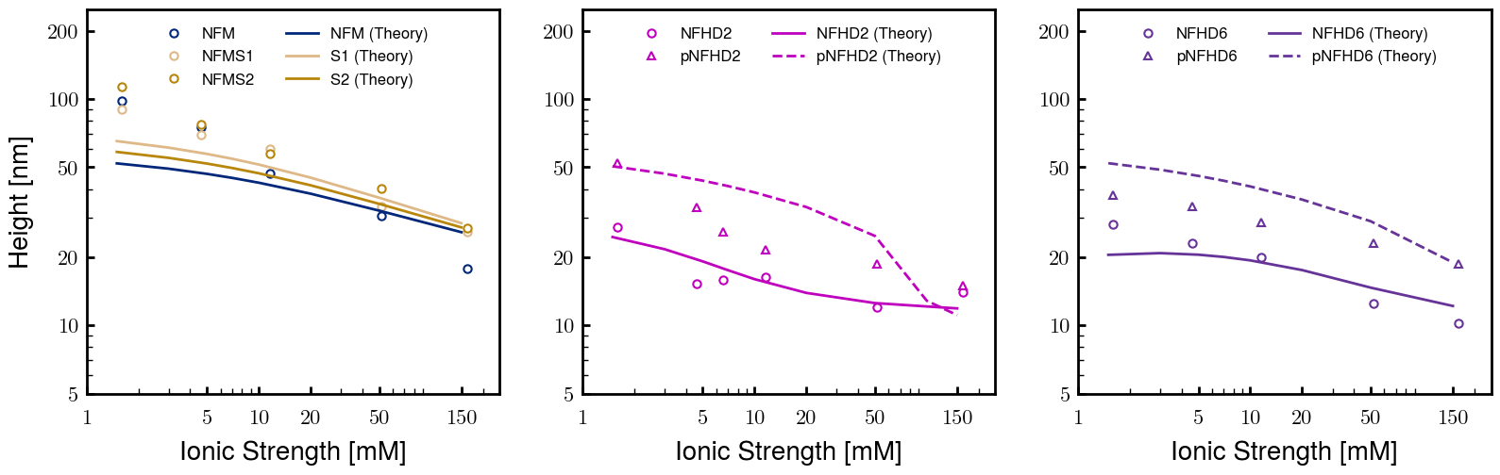
Agreement with AFM-measured heights
Unmodified
Modified
Chosen for best agreement with experimentally measured heights: $b=0.60 nm, ν=0.05 nm^{3}$. phospho H, $ν=0.15 nm^{3}$. Thresh $φ_{p}=1E−04$

Slide 8
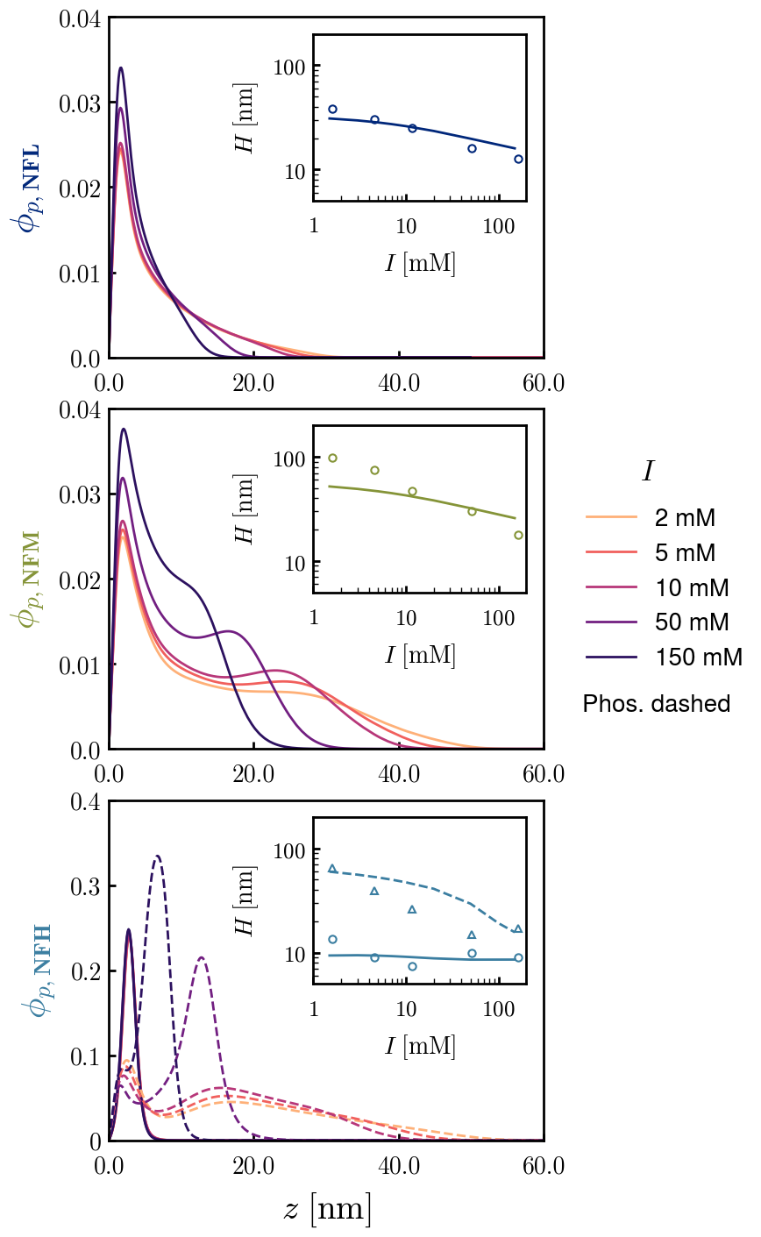
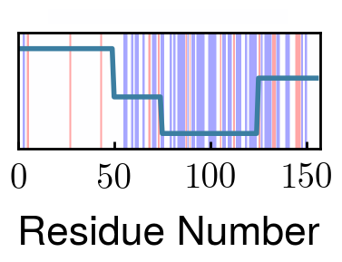
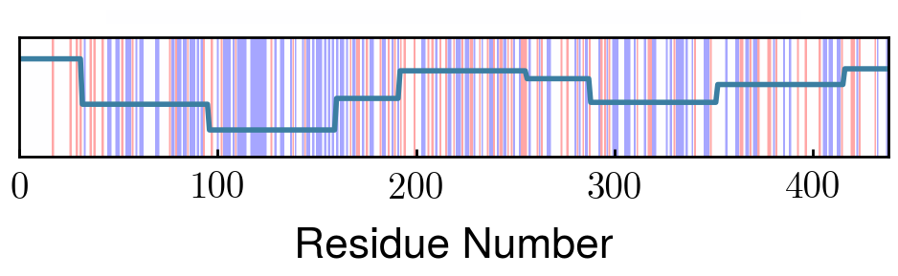
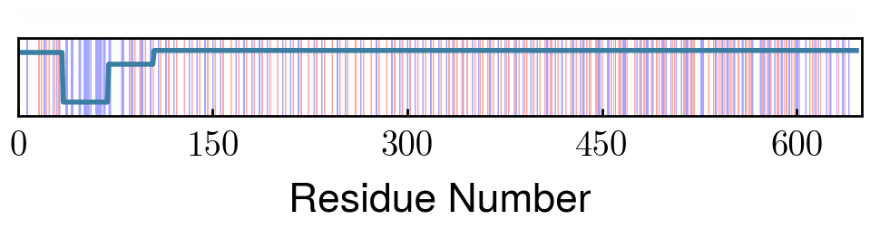
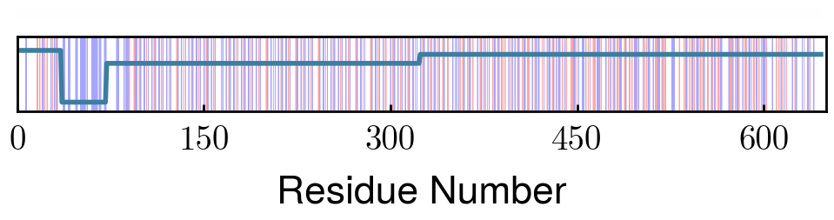
Effect of Sequence on Morphology (Unmodified proteins)
NFL
Progressively increasing charge distribution extends tail
NFM
Bimodal (peaks at Block 3 & 7) charge distribution creates shoulder
NFH
Non-phospho nearly net-neutral charge
Block 2 repels phospho. Block 3 (KSP units), preventing total collapse of outer layer
pNFH

Slide 9
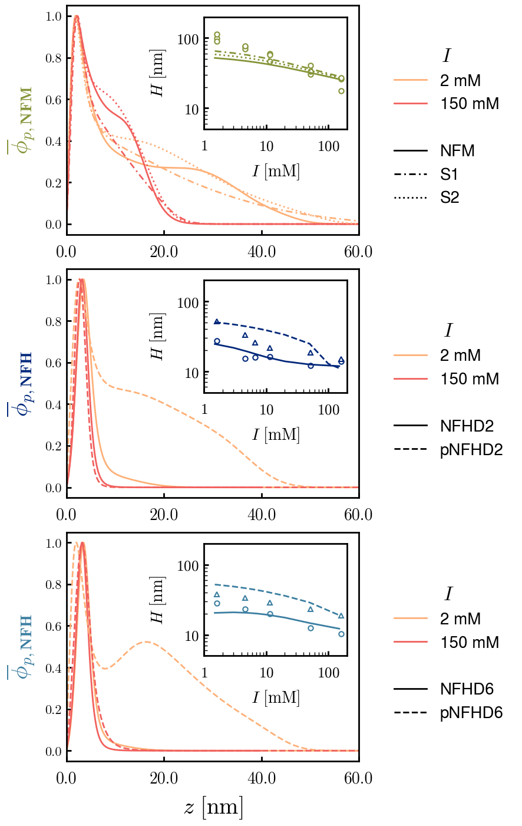
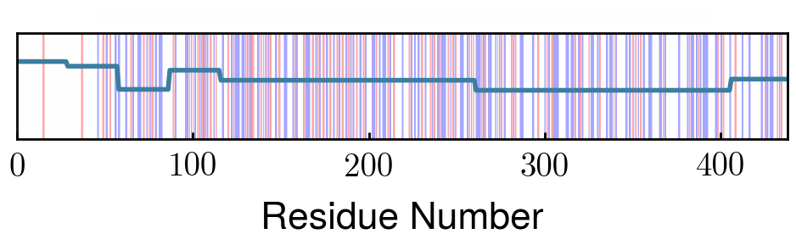
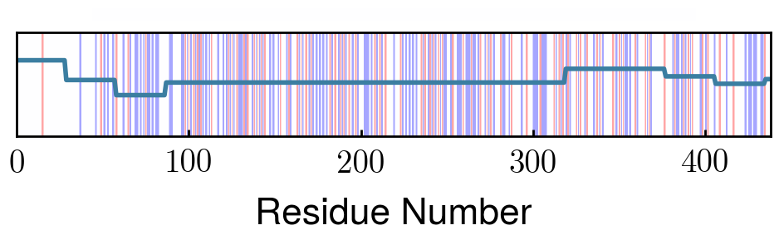
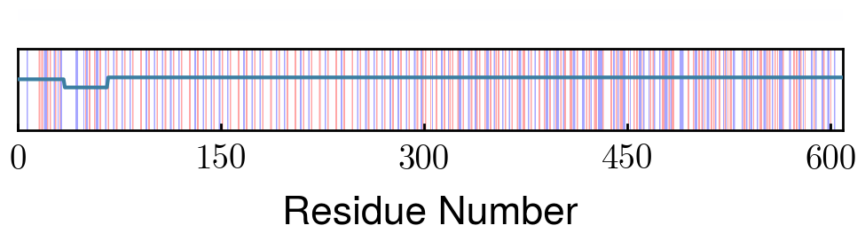
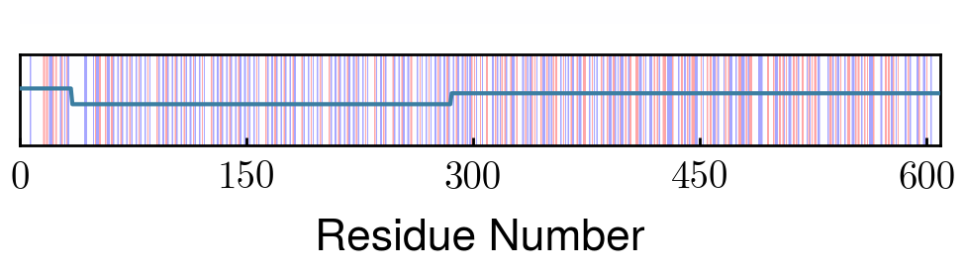
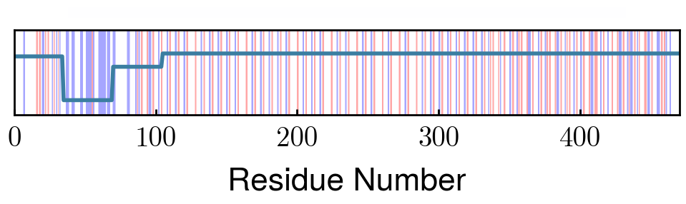
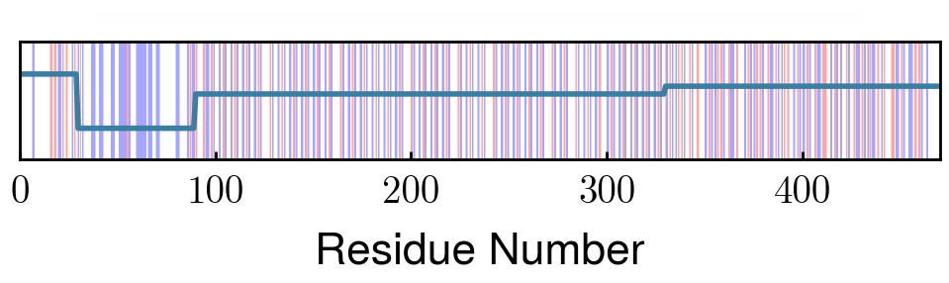
Effect of Sequence on Morphology (Modified proteins)
NFM
S1
Shuffled charge distributions lead to brushes with less prominent shoulders
S2
NFHD2
Deletion of Block 2 prevents shoulder in pNFH density at all ionic strengths (see prev. slide)
pNFHD2
NFHD6
Block 6 charge density -0.01 ~ -0.02e (phospho)
pNFHD6
Deletion of Block 6 reduces neutralizing charge in NFH and repulsion in pNFH.
Densities normalized to compare different proteins on same plot

Slide 10
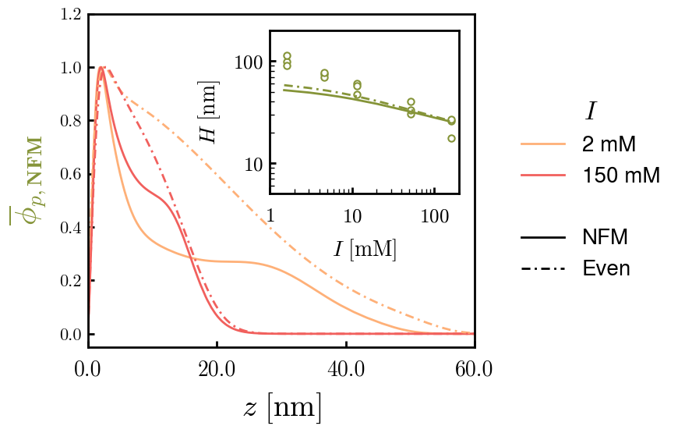
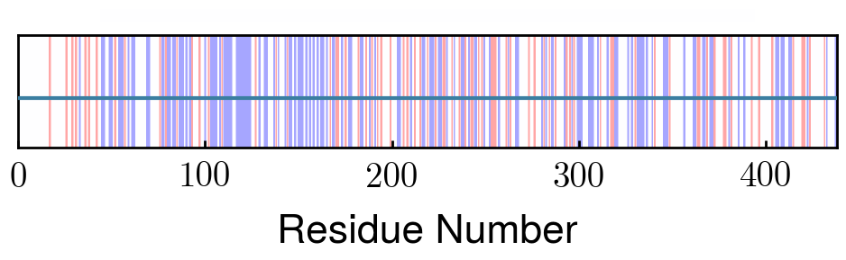
Alternate figure for modified NFM
NFM
S1
Shuffled charge distributions lead to brushes with less prominent shoulders
S2
Even

